Slide 1
Chapter: 6.9
Chromatography

Slide 2
Data from chromatography techniques, including thin layer chromatography (TLC), gas chromatography (GC), and high-performance liquid chromatography (HPLC), can be used to determine the composition and purity of substances; the separation of the components is caused by the variation in strength of the interactions between atoms, molecules or ions in the mobile and stationary phases. ( Syllabus)
Chromatographic techniques, including thin layer chromatography (TLC), gas chromatography (GC), and high performance liquid chromatography (HPLC), are used to determine the components of a wide range of mixtures in various settings. The decision to use a particular chromatographic technique depends on a number of factors, including the properties of the substances being separated, the amount of substance available for analysis and the sensitivity of the equipment. Chromatographic techniques have a wide range of analytical and forensic applications, including monitoring air and water pollutants, drug testing of urine and blood samples, and testing for food additives and quality. (Syllabus)

Slide 3
Chromatography
It is one of the most widely used laboratory techniques for the separation and identification of the substances in a mixture.
Chromatography is a very useful technique for finding the concentration of each substance in a mixture.
Three simple forms of techniques include paper chromatography, thin-layer chromatography and column chromatography.

Slide 4
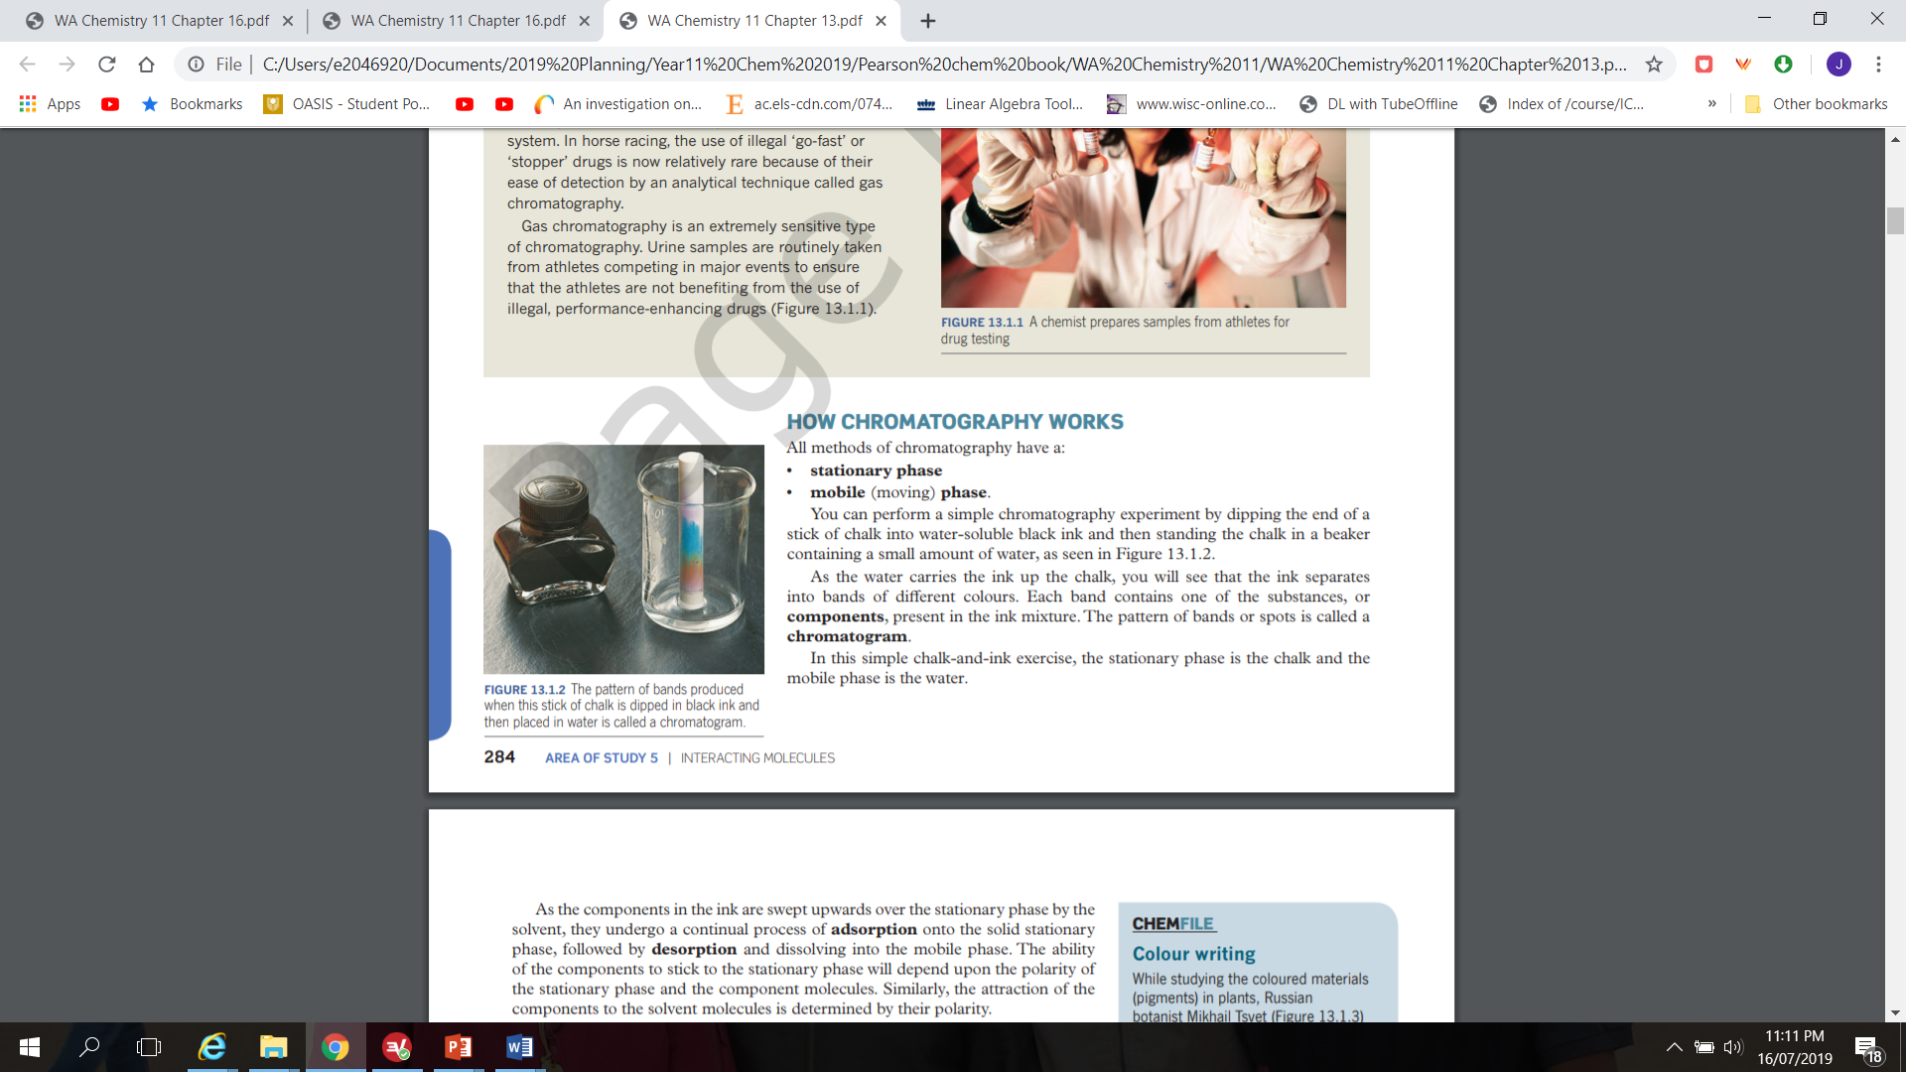
How chromatography works
All methods of chromatography have a:
Stationary phase
Mobile (moving) phase
A simple chromatography experiment: Dip the end of a chalk into water-soluble black ink and then standing the chalk in a beaker containing a small amount of water. As the water carries the ink up the chalk, the ink separates into bands of different colours. Each band contains one of the substances or components, present in the ink mixture. The pattern of bands or spots is called a chromatogram.
Here, stationary phase is the chalk and mobile phase is the water.
https://www.youtube.com/watch?v=1Zosz9T_EPA

Slide 5
As the components in the ink are swept upwards over the stationary phase by the solvent, adsorption onto the solid stationary phase, followed by desorption and dissolving into the mobile phase will happen.
The ability of components stick to the stationary phase will depend upon the polarity of the stationary phase and the component molecules. The attraction of the components to the solvent molecules is determined by their polarity.

Slide 6
By altering the solvent( mobile phase) and the surface ( stationary phase), chemists can separate a mixture of solutes.
Chromatography is the name of the group of techniques that separate substances based upon differential distribution between a stationary phase and a mobile phase.

Slide 7
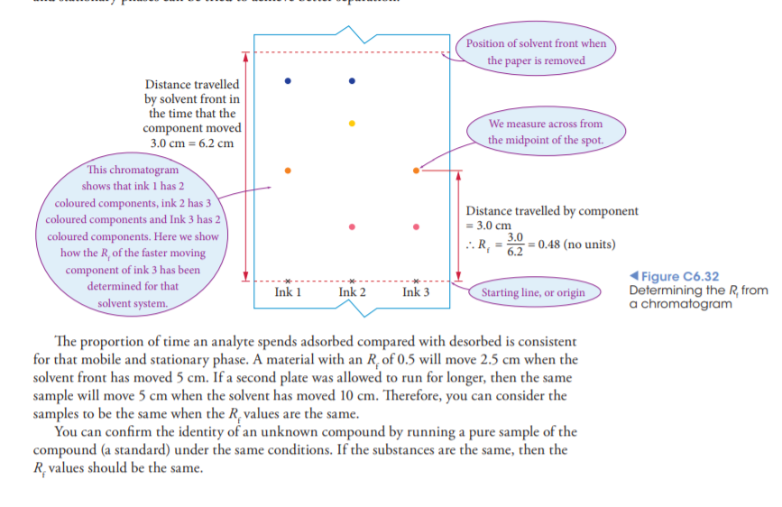
Thin layer chromatography
TLC is used to separate and analyse a wide variety of molecular mixtures. This is more faster and provides more separation than paper chromatography. TLC used to analyse drugs and amino acids.
The TLC plate consists of a 0.1 mm – thick of absorbent material bonded to a glass or plastic support. The absorbent material consists of microscopic plates. These surfaces provide large surface area for chromatographic separation. This is the stationary phase. The origin line is drawn in pencil about 1cm from the base, samples are placed in this area.
https://www.youtube.com/watch?v=U2BKeT8toLQ

Slide 9
Separation is done by the solvent (mobile phase) moving up the stationary phase. This movement is due to capillary action.
The solvent moves through the samples towards the top of the plate. The faint wavy line is called the solvent front. The samples get desorb into solvent and then travel up the plate with the solvent.
If all components spent the same amount of time in the solvent , then they would travel at the same rate. As components have differences in chemical structure adsorption and desorption rates will vary for the components.

Slide 10
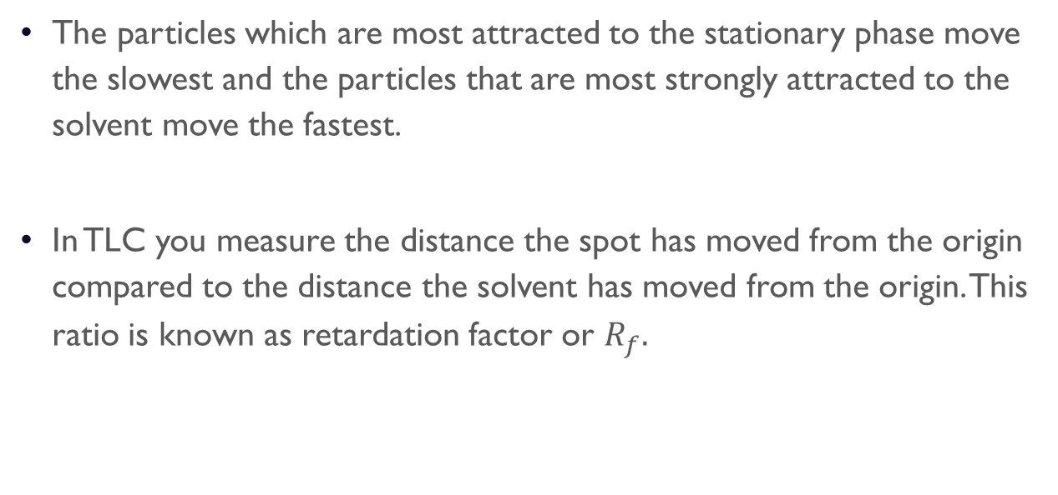
The particles which are most attracted to the stationary phase move the slowest and the particles that are most strongly attracted to the solvent move the fastest.
In TLC you measure the distance the spot has moved from the origin compared to the distance the solvent has moved from the origin. This ratio is known as retardation factor or $R_{f}.$

Slide 11
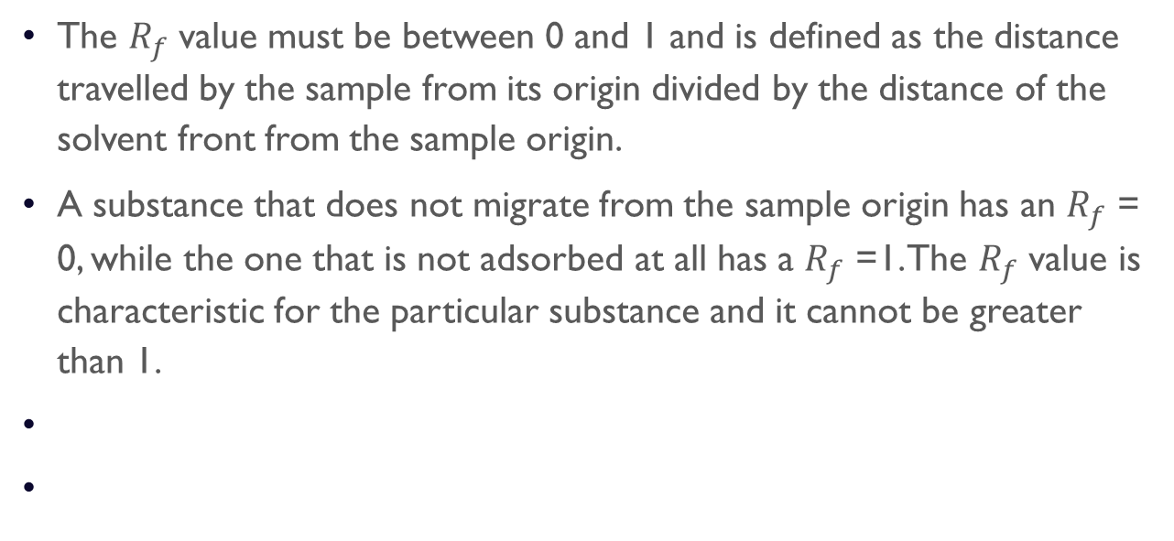
The $R_{f}$ value must be between 0 and 1 and is defined as the distance travelled by the sample from its origin divided by the distance of the solvent front from the sample origin.
A substance that does not migrate from the sample origin has an $R_{f}$ = 0, while the one that is not adsorbed at all has a $R_{f}$ =1. The $R_{f}$ value is characteristic for the particular substance and it cannot be greater than 1.

Slide 12
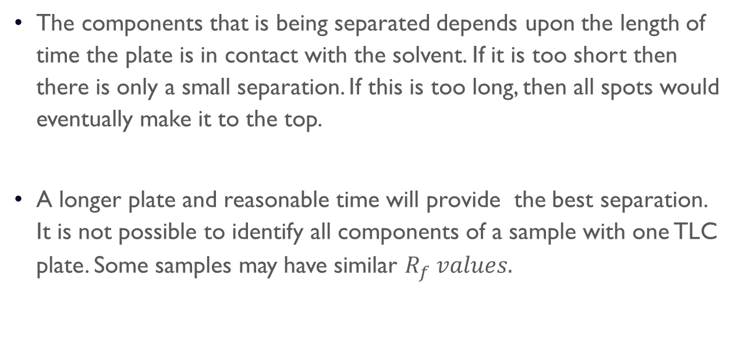
The components that is being separated depends upon the length of time the plate is in contact with the solvent. If it is too short then there is only a small separation. If this is too long, then all spots would eventually make it to the top.
A longer plate and reasonable time will provide the best separation. It is not possible to identify all components of a sample with one TLC plate. Some samples may have similar $R_{f} values.$

Slide 13
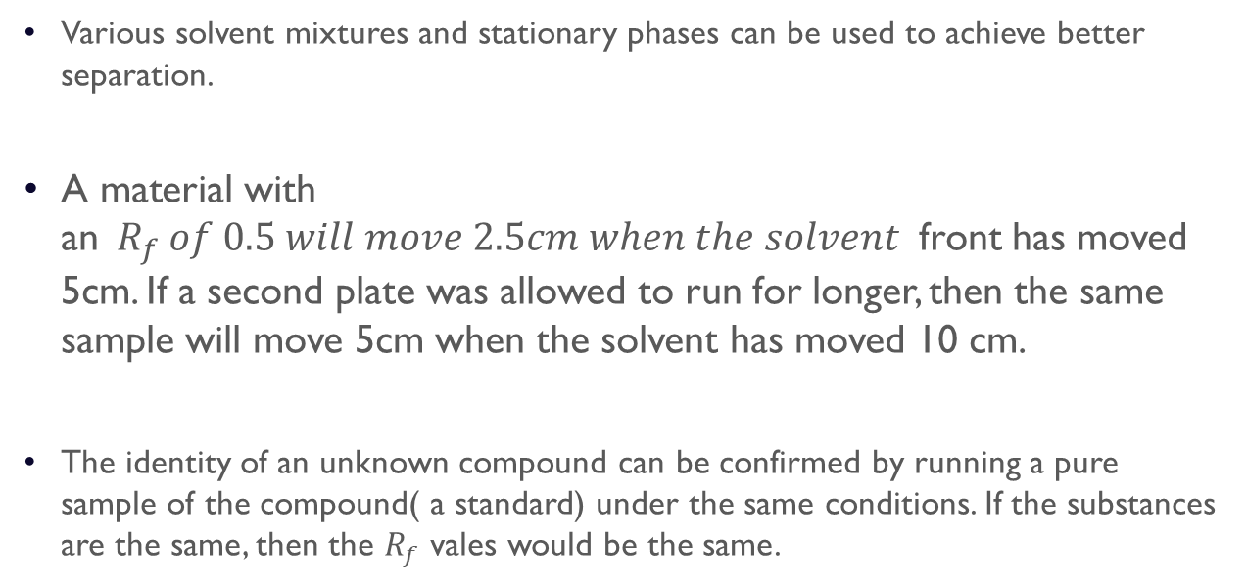
Various solvent mixtures and stationary phases can be used to achieve better separation.
$\text{A} \text{material} \text{with} \text{a}\text{n} R_{f} of 0.5 will move 2.5cm when the solvent$front has moved 5cm. If a second plate was allowed to run for longer, then the same sample will move 5cm when the solvent has moved 10 cm.
The identity of an unknown compound can be confirmed by running a pure sample of the compound( a standard) under the same conditions. If the substances are the same, then the $R_{f}$ vales would be the same.

Slide 14
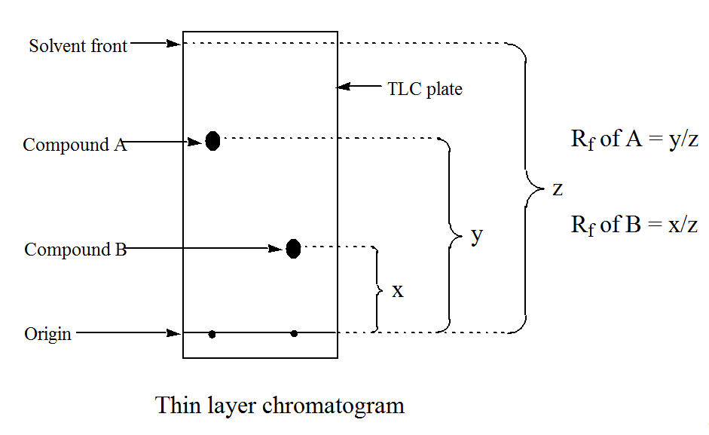

Slide 15
Gas chromatography
https://www.youtube.com/watch?v=4Xaa9WdXVTM
Gas chromatography (GC) is a separation technique for small organic molecules which can withstand relatively high temperatures.
Application of gas chromatography
For measurement of blood alcohol levels.
Gas chromatograph consists of a gas bottle, an oven, a column, a detector and a recorder. The sample is injected into the oven where the gas pushes the sample into a long thin column. In the column, smaller particles or those that adsorb onto the stationary phase the least leave the column first. Larger particles or those that more readily take longer to leave the column.

Slide 16
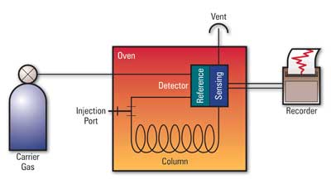
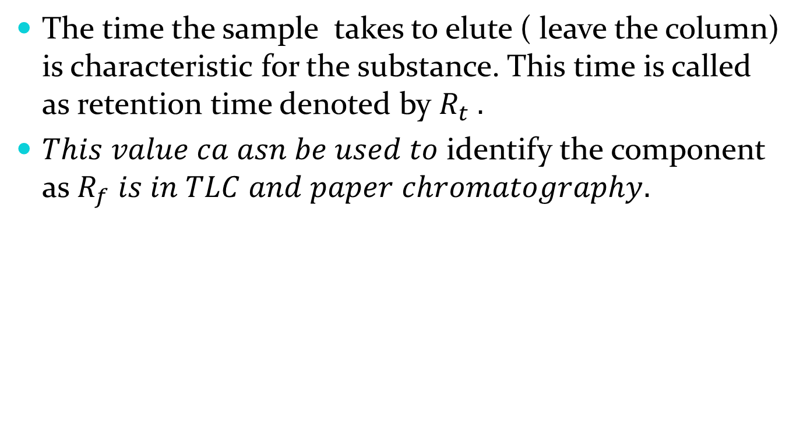
The time the sample takes to elute ( leave the column) is characteristic for the substance. This time is called as retention time denoted by $R_{t} .$
$This value ca asn be used to$identify the component as $R_{f} is in TLC and paper chromatography.$

Slide 17
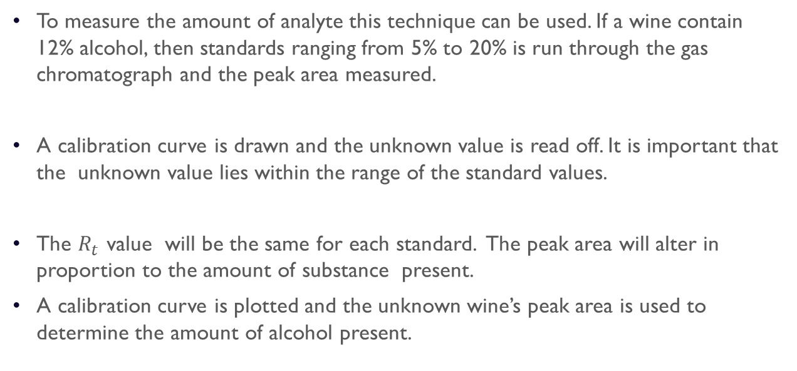
To measure the amount of analyte this technique can be used. If a wine contain 12% alcohol, then standards ranging from 5% to 20% is run through the gas chromatograph and the peak area measured.
A calibration curve is drawn and the unknown value is read off. It is important that the unknown value lies within the range of the standard values.
The $R_{t}$ value will be the same for each standard. The peak area will alter in proportion to the amount of substance present.
A calibration curve is plotted and the unknown wine’s peak area is used to determine the amount of alcohol present.

Slide 18
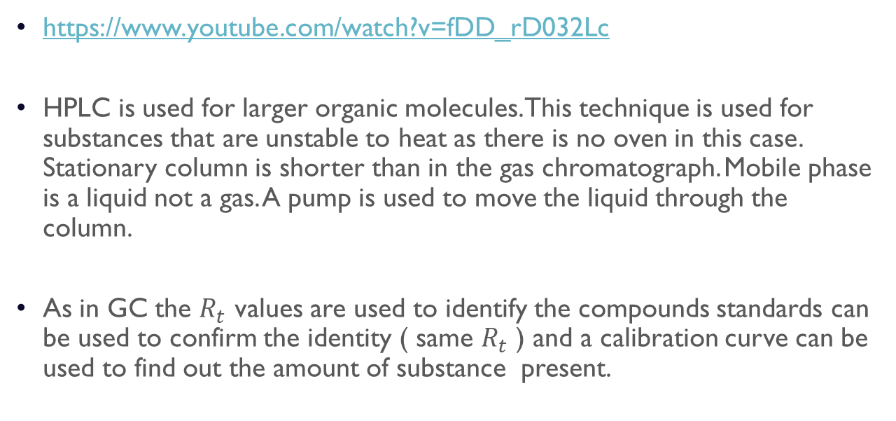
High performance liquid chromatography
https://www.youtube.com/watch?v=fDD_rD032Lc
HPLC is used for larger organic molecules. This technique is used for substances that are unstable to heat as there is no oven in this case. Stationary column is shorter than in the gas chromatograph. Mobile phase is a liquid not a gas. A pump is used to move the liquid through the column.
As in GC the $R_{t}$ values are used to identify the compounds standards can be used to confirm the identity ( same $R_{t}$ ) and a calibration curve can be used to find out the amount of substance present.

Slide 19
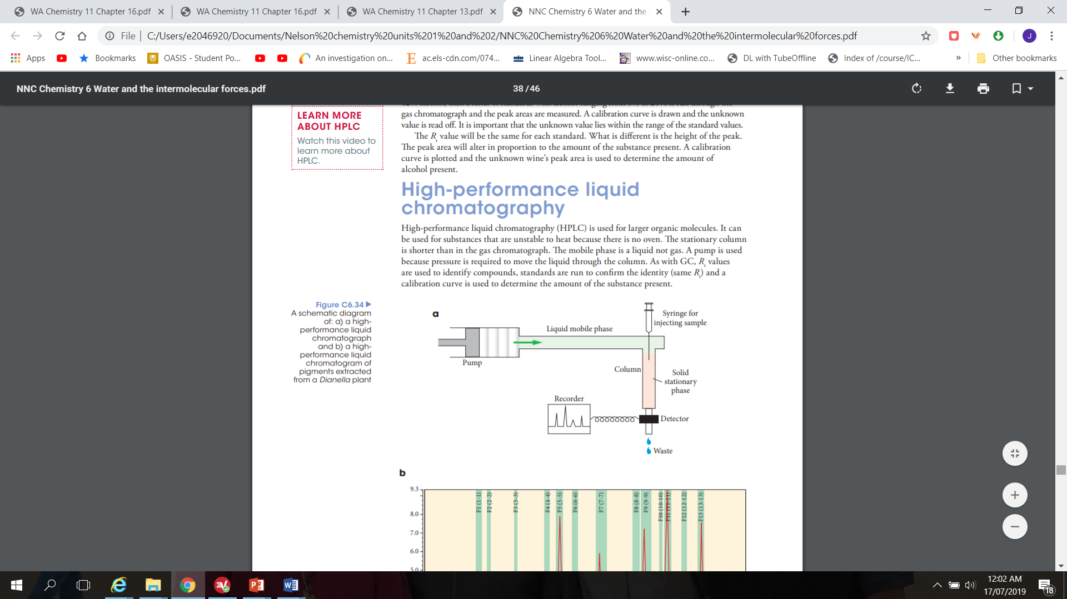

Slide 20
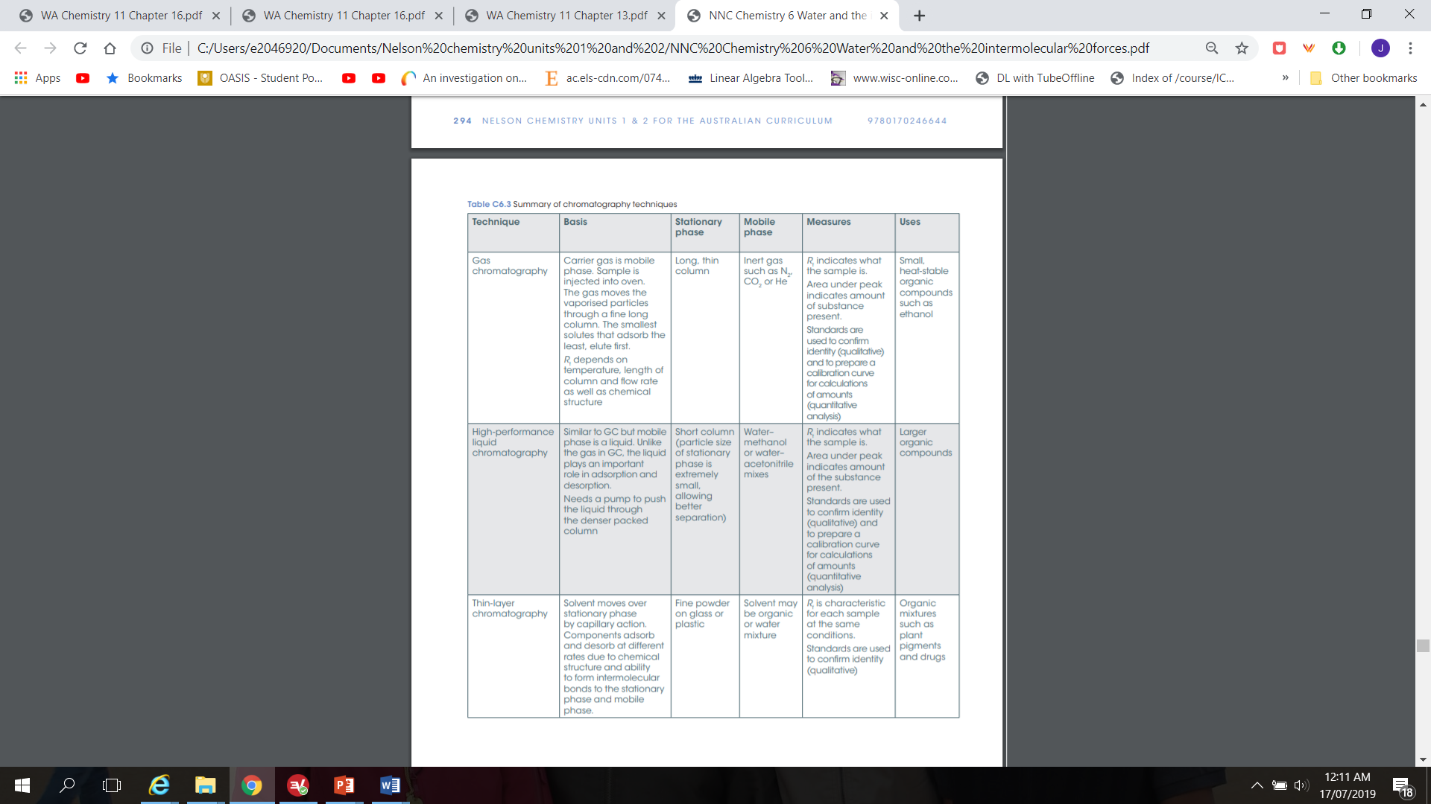
Summary of chromatography techniques

Slide 21
Questions
Essential Chemistry Unit 1&2
Page: 167- 169: set: 33 Q: 1,4,5, 8 and 9

